Slide 1
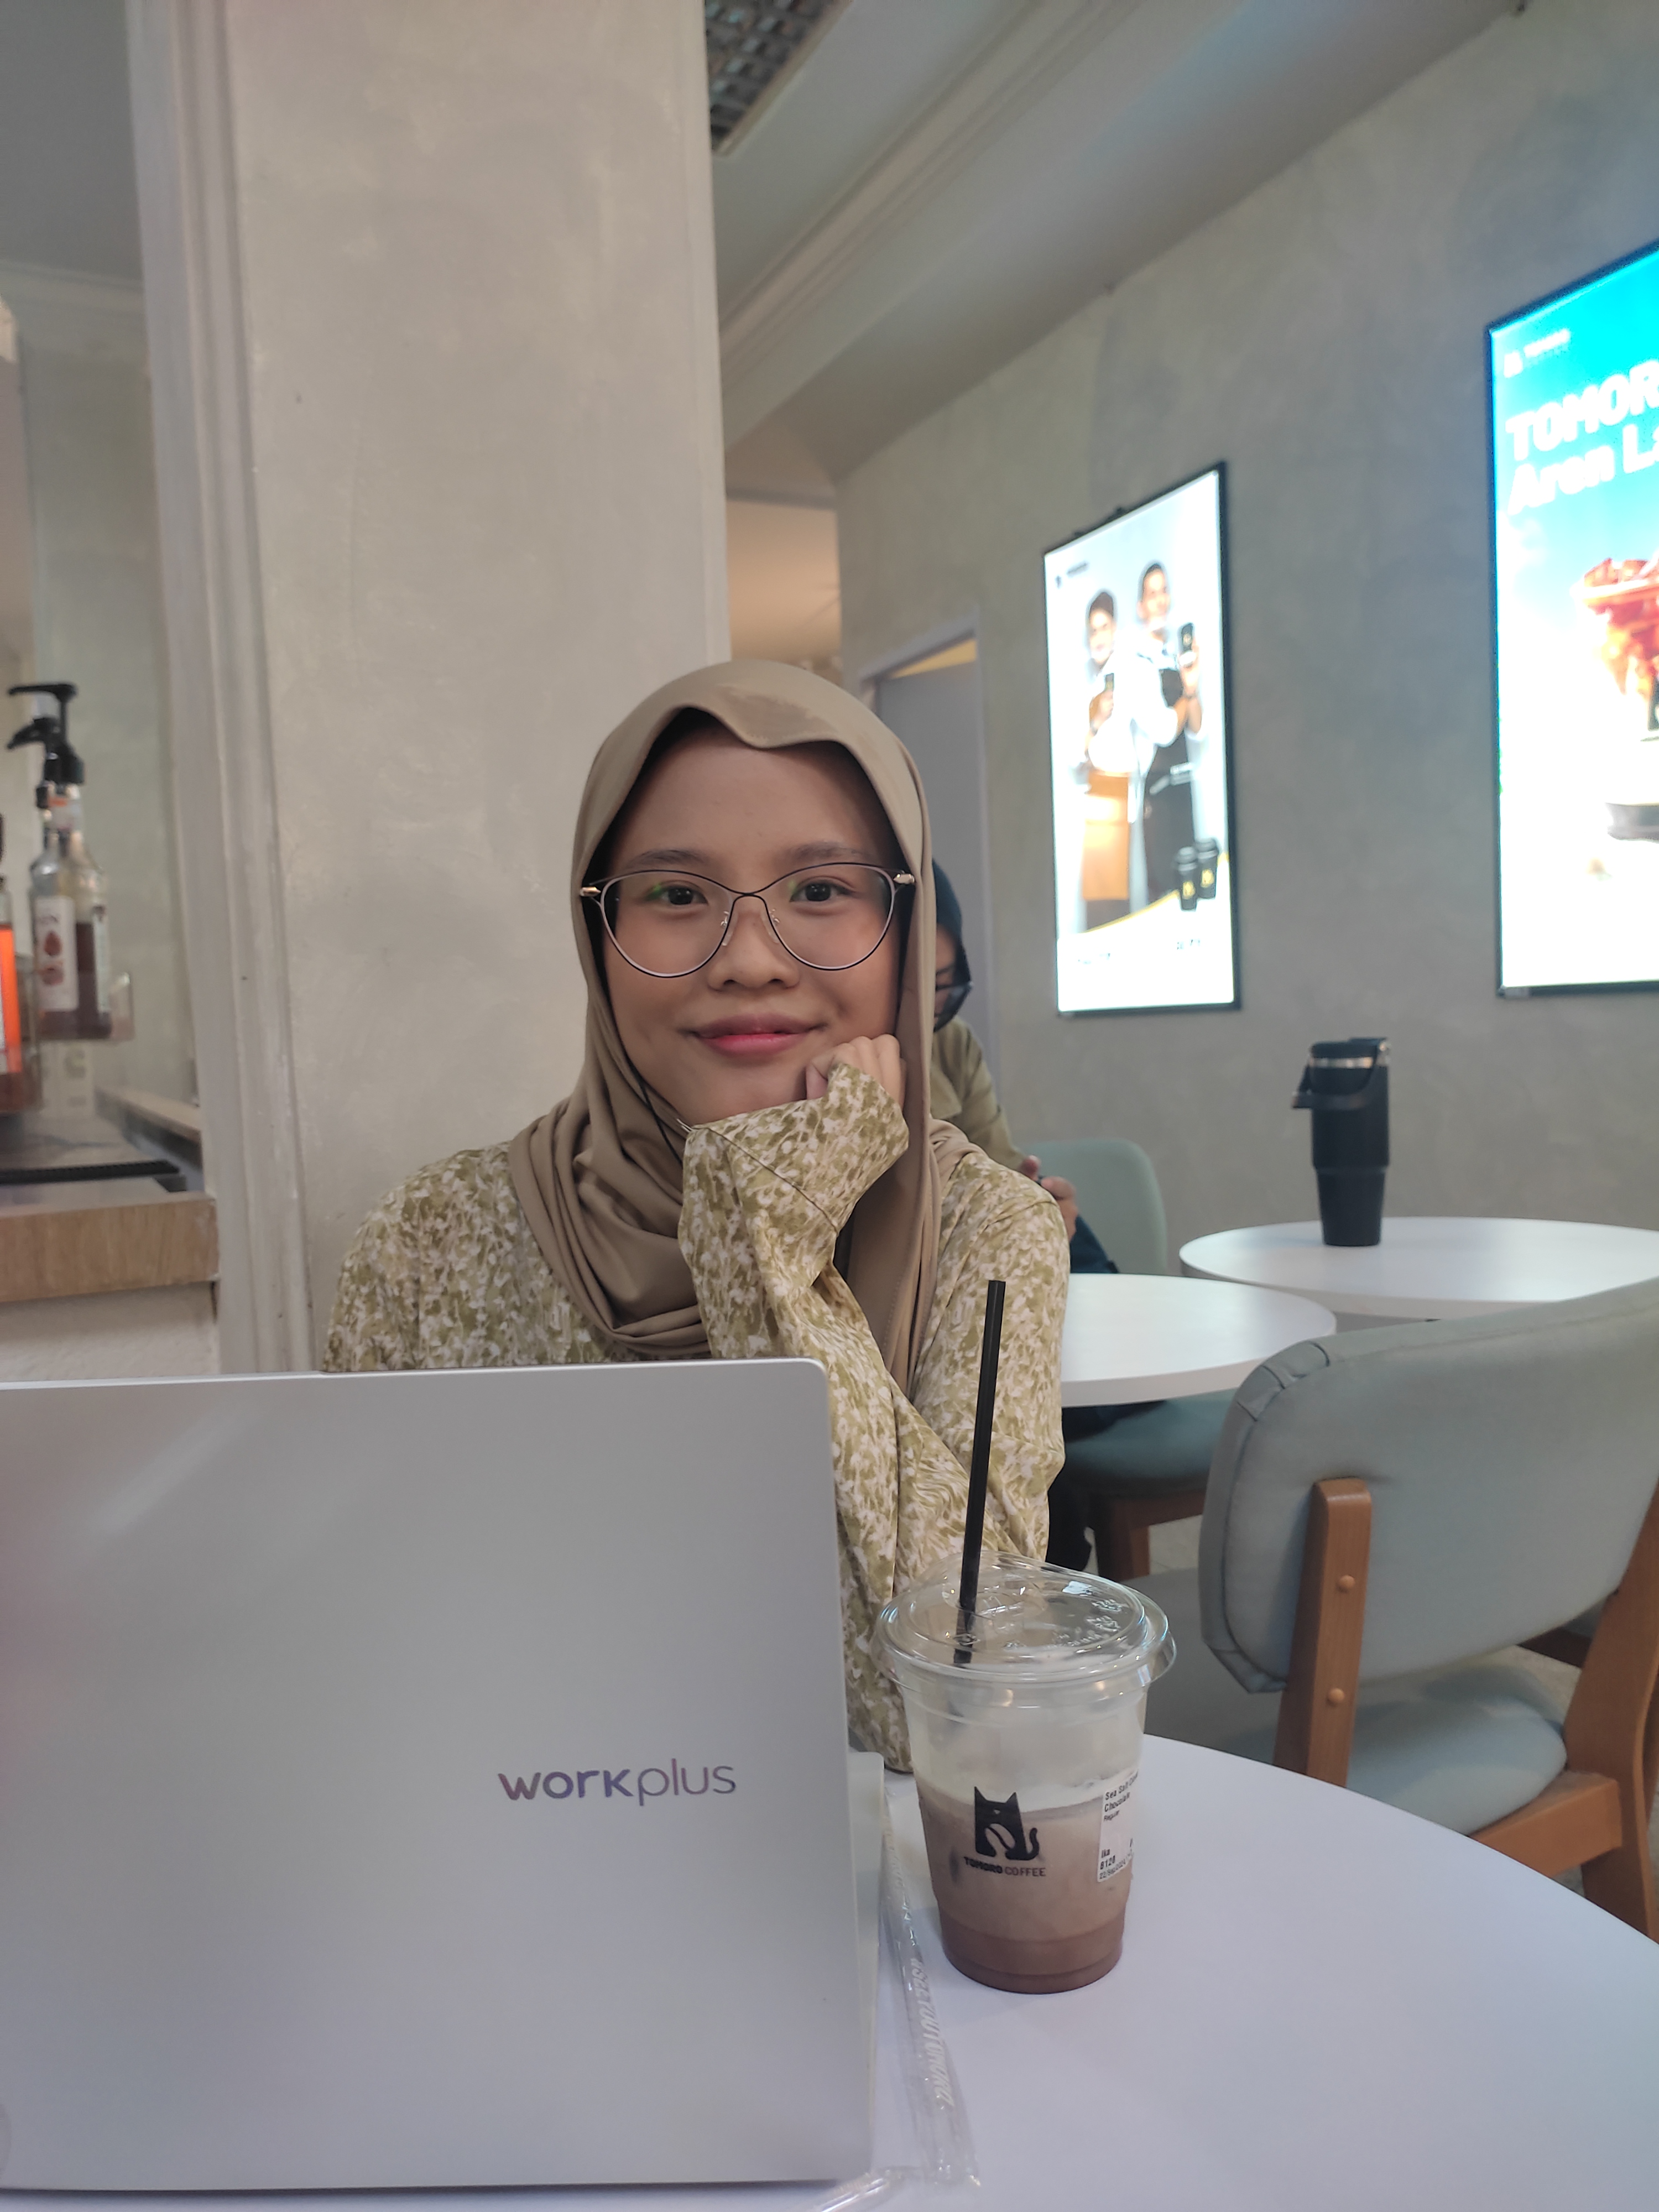
Projek Akhir Bootcamp QA Engineer Sanbercode
Ika Musarijatul Lathifah​

Slide 2
Agenda
1
2
3
4
5
Introduction
Project Name
Features
Demo
Summary

Slide 3
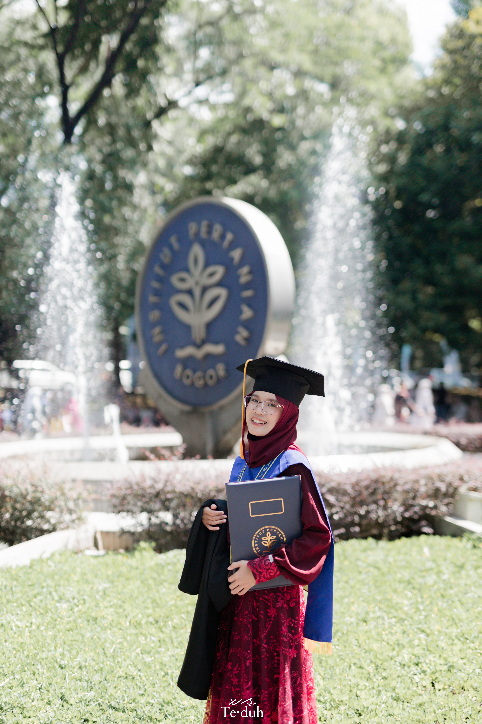
Introduction
Ika Musarijatul Lathifah
Fresh Graduate from IPB University
Bhacelor’s Degree of Mathematics
Lampung

Slide 4

Automation Testing with Cypress

Slide 5
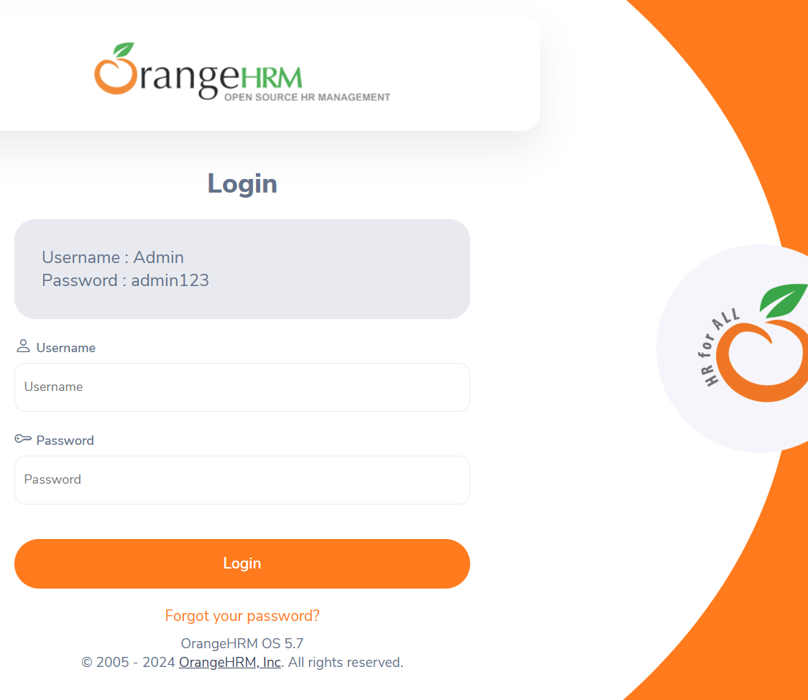
https://opensource-demo.orangehrmlive.com/web/index.php/auth/login

Slide 6




Features worked on
Login
Forgot Password
Directory

Slide 7
How we get there​
Login​
Forgot Password
Directory​
Test Function Login with Valid Credentials
Test Function Login with Invalid Credentials
Test Function Login with Invalid Uppercase
Test Function Login with Blank Input
Test Function Login with User Doesn’t Exist ​Test Function Login with Space Between
Test Function Button Forgot Password​
Test Function Forgot Password​ with Valid Credentials
Test Function Forgot Password​ Canceled
Test Function Directory​ with Valid Credentials 1
Test Function Directory​ with Valid Credentials 2

Slide 8
Demo Fitur Login

Slide 9
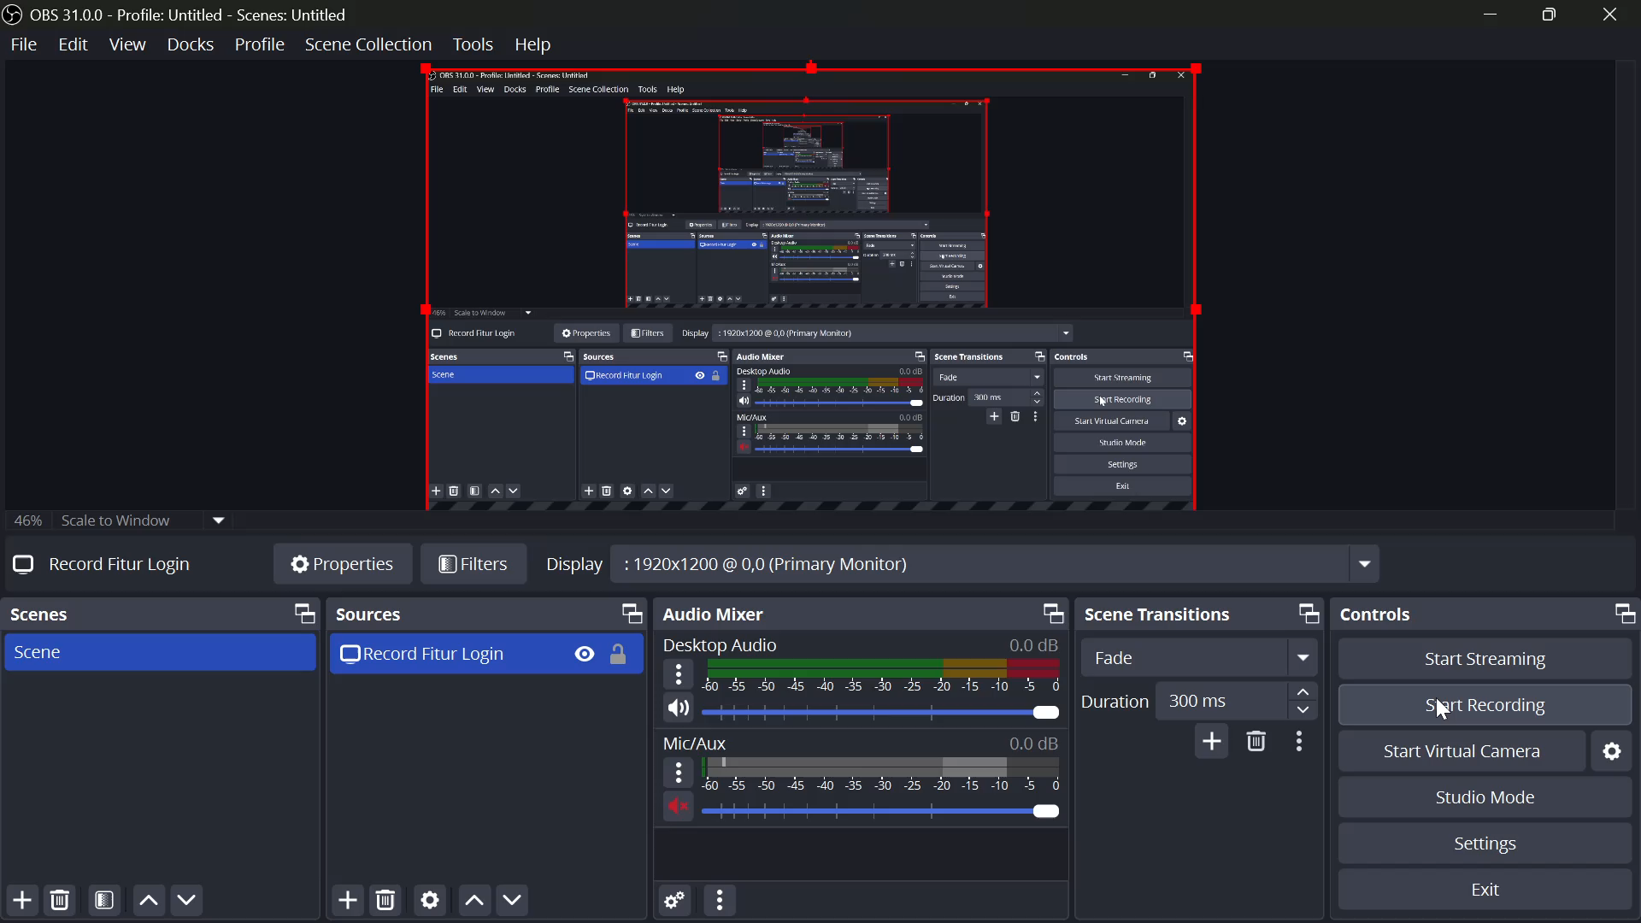

Slide 10
Demo Fitur Forgot Password

Slide 11

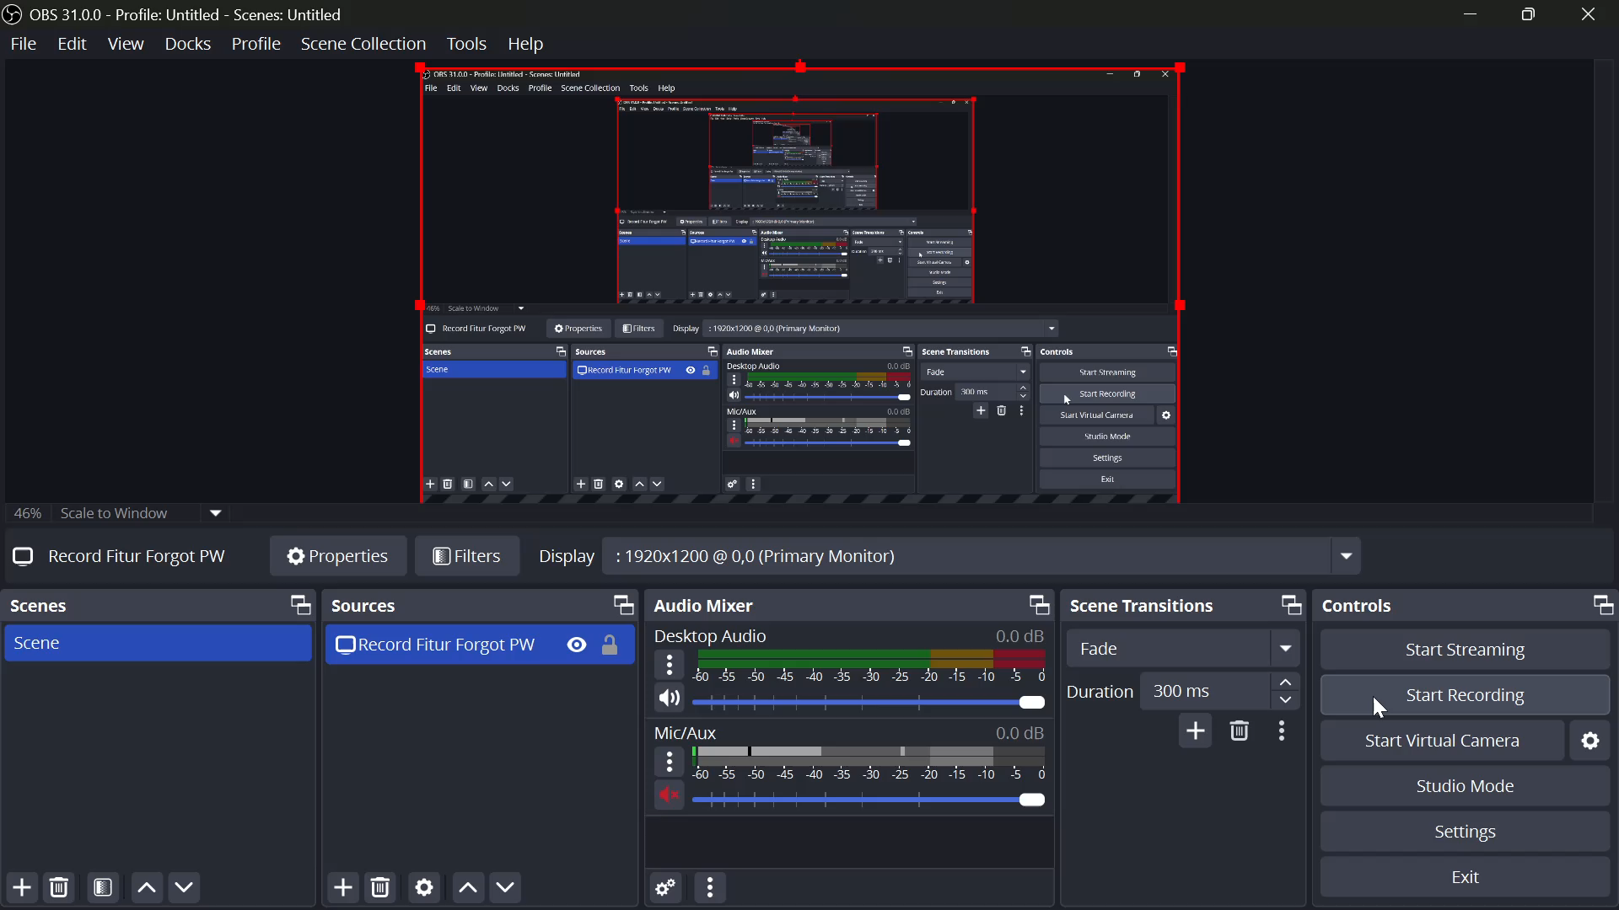

Fitur Login

Slide 12
Demo Fitur Directory

Slide 14
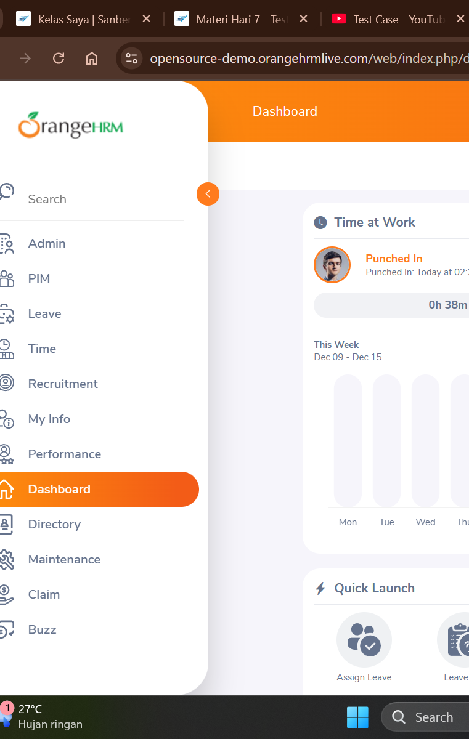
Summary

Slide 15

Thank you
Mirjam Nilsson
mirjam@contoso.com
www.contoso.com

